Slide 1
Topic of Presentation :
Text-Adaptive Generative Adversarial Networks(TAGAN): Manipulating Images with Natural Language
Submitted by,
Name: Rafid Mostafa ID: 16101069
CSE431:Natural Language Processing

Slide 2
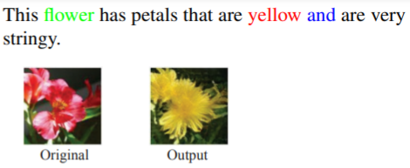
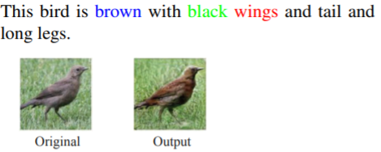
Introduction
Problem statement:
>Manipulating images using natural language description.
Audience:
>Personal or professional photographers; > Personal or professional photo editors;

Slide 3
Earlier /Posterior works
Models used :
CUB ;
cGAN ;
Attribute2Image ;
InfoGAN ;
DCGAN ;
StackGAN ;
AttnGAN ;

Slide 4
Contributions
> A novel text-conditioned visual attribute manipulation method called TAGAN ;
>Introduces a text-adaptive discriminator that consists of word-level local discriminators.
>Outperforms all the existing methods.

Slide 5
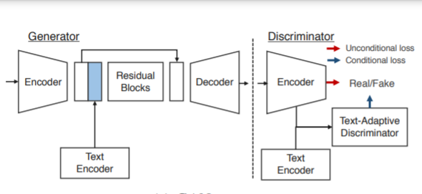
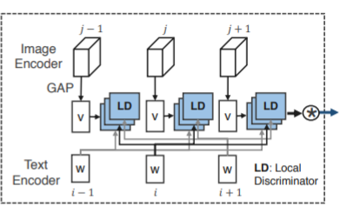
Preliminaries
GAN(General Adversarial Network):
Text Adaptive Discriminator:
GAN TAD

Slide 6
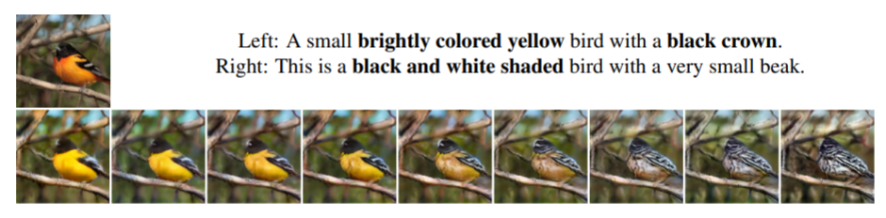
Results
Accuracy ;
Naturalness ;
Less error ;

Slide 7
CONCLUSION
Restatement:
>Manipulating images using natural language description.
Opinion:
Is it really better ?
Is it all successful?
Is it helpful to the community?

Slide 8
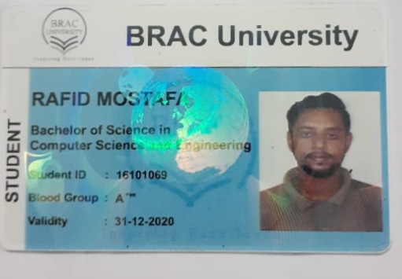
Any questions ?
Here is my credentials .Thank you.

